Slide 1
Internship in Munich

Slide 2
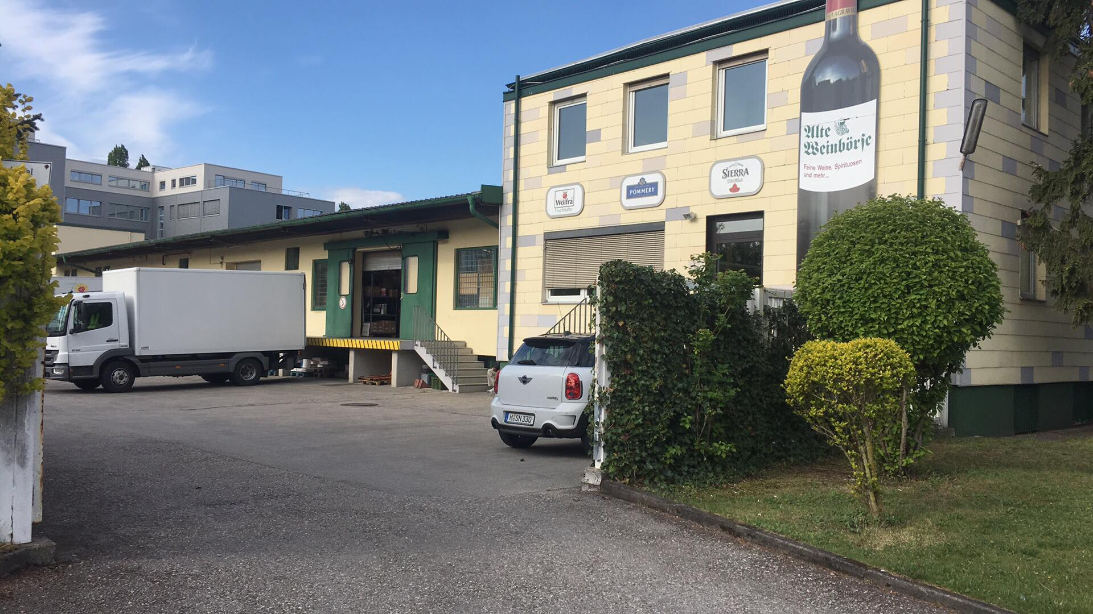
My company:
Alte Weinbörse - wholesale

Slide 3
Company History:
In 1972, Henning Schulz, then a restaurateur and winemaker in his wine cellar, founded the Alte Weinbörse wine shop. Wineries belonged to the family. Henning Schulz combined love for wine and his contacts with Munich gastronomy on the stage with great creativity and thus laid the foundations for a successful company.

Slide 4
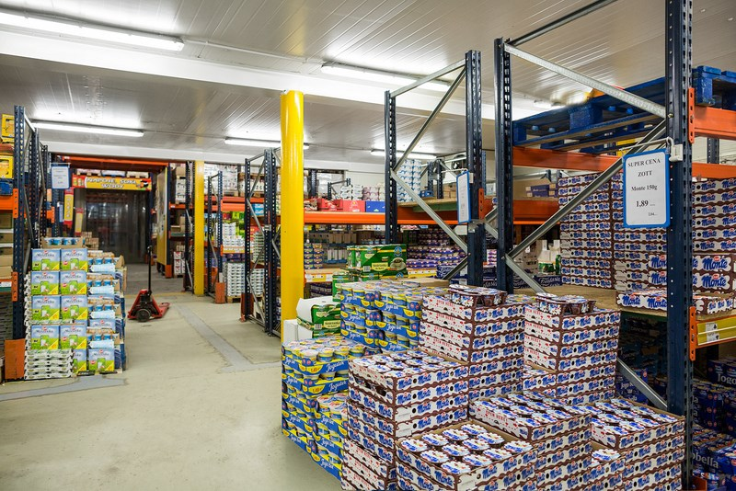
What does Alte Weinborse do?
Wholesaler Alte Weinborse deals in the wholesale and retail sale of alcohol, beer, wine, juices, beverages and water. It is a small company that employs not many employees, but there is a friendly atmosphere.

Slide 5
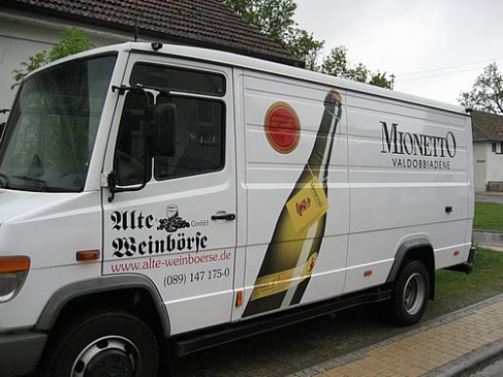
Execution of the contract
1. Placing an order by the customer 2.Checking the product availability in the warehouse
3. Order picking process
4. The supplier delivers the order to the buyer

Slide 6
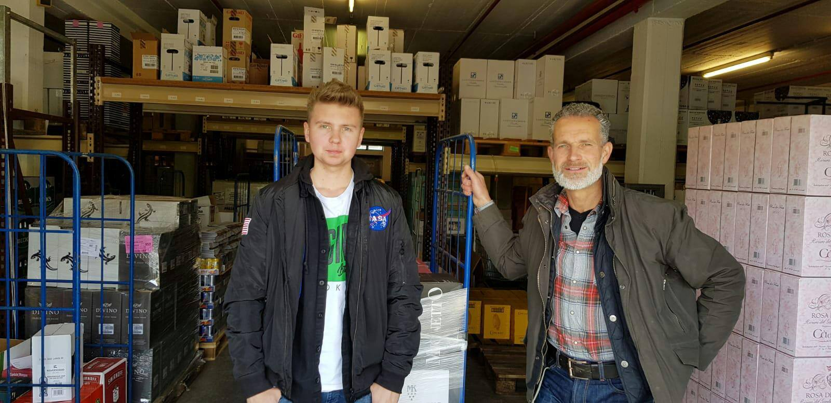
My tasks in the company
My main task was to complete orders. I also got to know the process of carrying out the order and all the procedures and documents related to it. I also got to know the work of a beverage supplier.

Slide 7
Free Time:

Slide 9
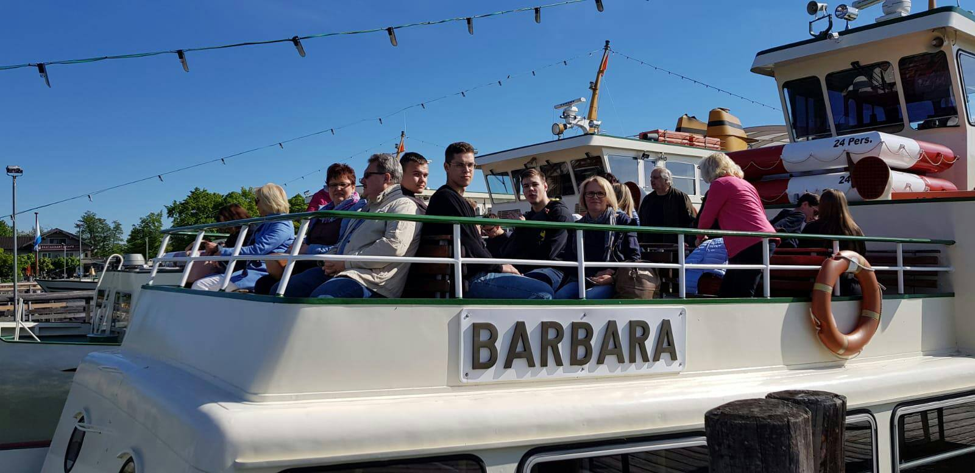

Slide 10
Thank you for your Attention!

